Slide 1
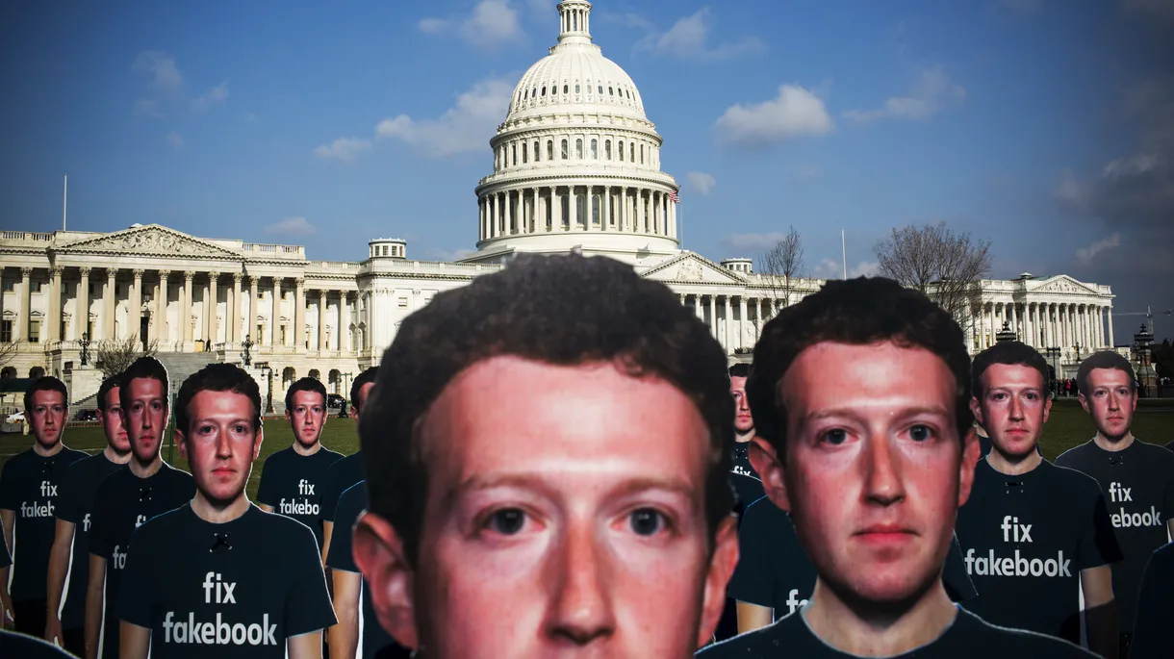
Privacy and Human Behavior in Facebook
Group 1b
Carlos Ramírez
Ivan Nemtsev
José Ramon Cobos
Alvaro Tapia
Niccolò Guerzoni Panichi
Xiaoyu Wang

Slide 2
Outline
Facebook - Cambridge Analytica scandal
Facebook Privacy Issue
Uncertainty
Context-dependence
Malleability and Influence
Conclusion
Kick-off question

Slide 3
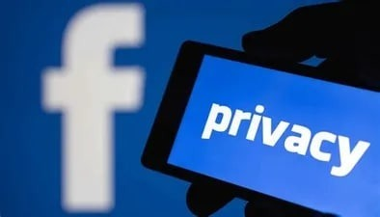
Are you aware of Facebook’s data privacy policy?

Slide 4
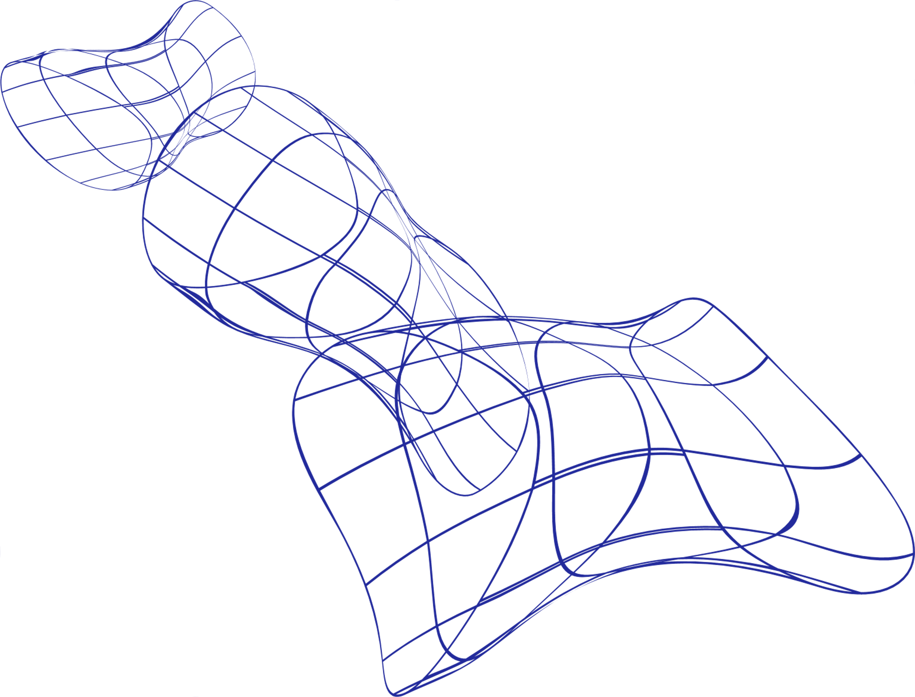
Facebook – Cambridge Analytica Scandal
2013: Cambridge professor creates app “ThisIsYourDigitalLife”​
300,000 downloads 87 million Facebook users involved ​
Data handled to Cambridge Analytica ​
Data targeted for political Right-Wing campaigns

Slide 5

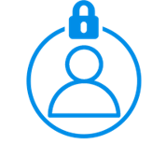
Data was illegally harvested
Facebook’s Privacy Issue
No data breach? Everyone involved gave their consent
Users didn’t change their privacy settings

Slide 6
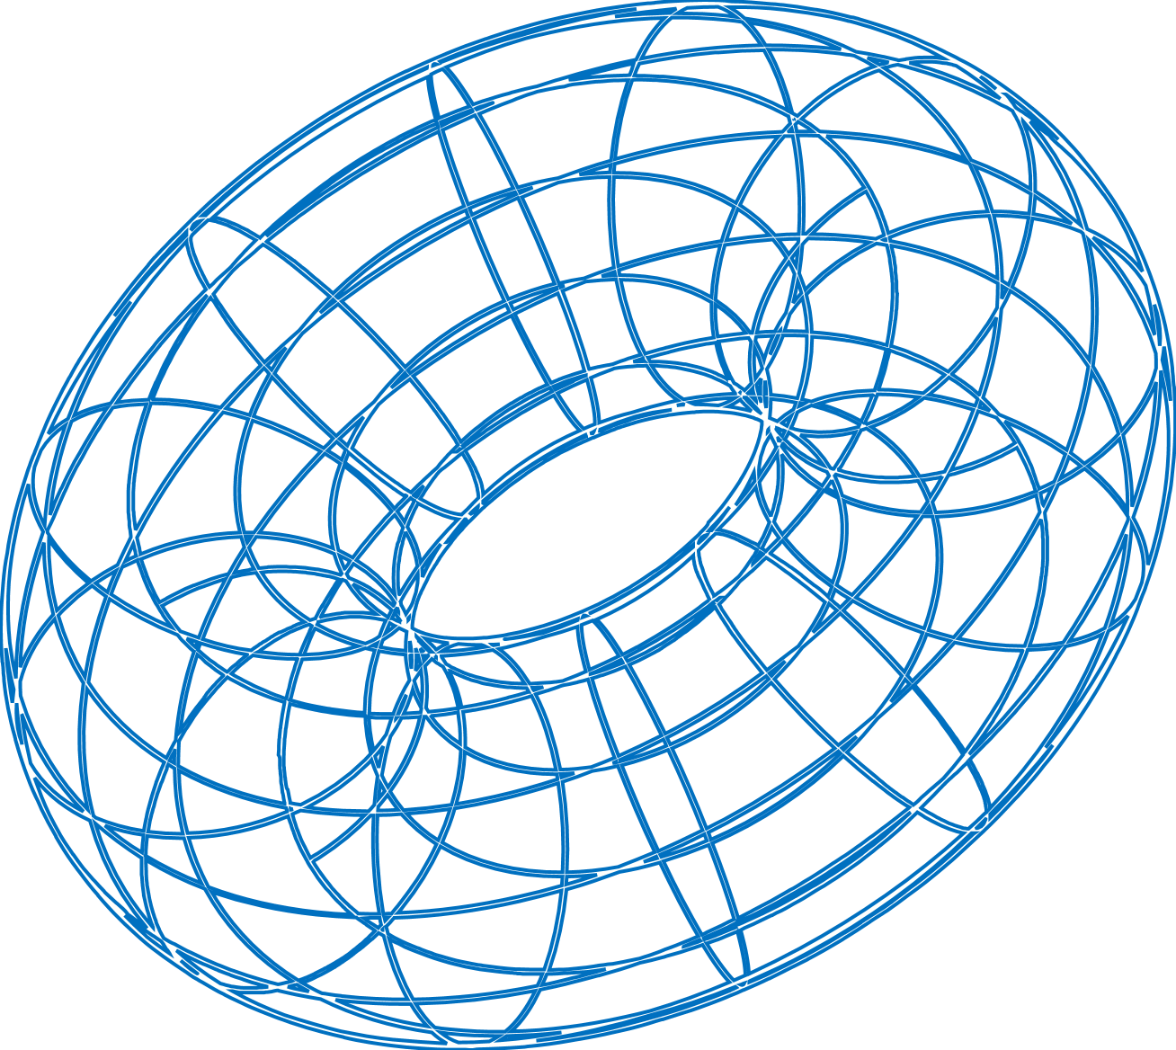
Uncertainty
Apps using Facebook data get your data but make your life easier. It’s a trade-off! (Stewart, E., 2018)
People are uncertain about what data are gathered and how they are used.
People think their data will be used to target ads, but that's just the top of the iceberg.

Slide 7
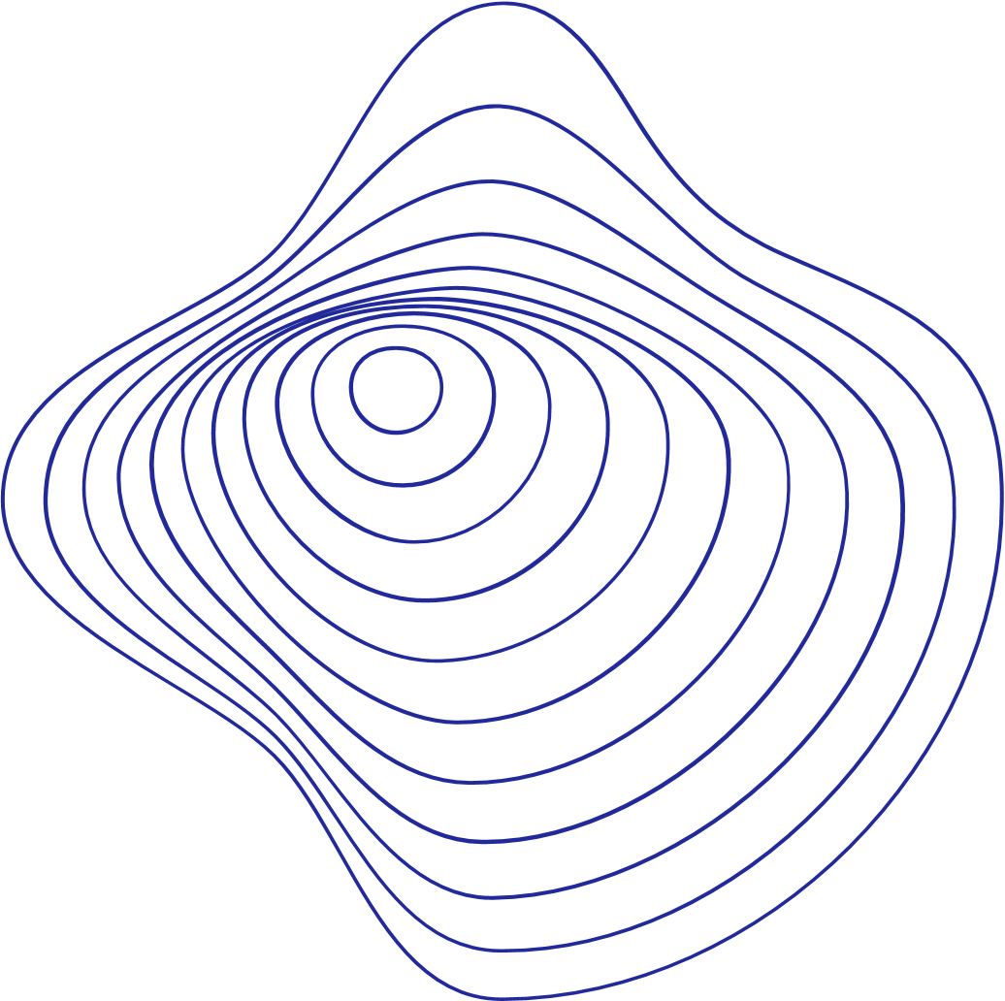
Uncertainty
Facebook sells to 150 companies to share its members' personal data. (BBC, 2018)
The data brokers: Datalogix, Epsilon, BlueKai, and Acxiom
1. Consumer records
2. Direct marketing
3. Credit bureaus
4. Government records
(Soft Cloud Tech)

Slide 8
Uncertainty
Privacy paradox: the same individual who expresses his concern exposes his information. (Awad & Krishnan, 2006)
Social penetration theory: online community activity enhances self-esteem. (Wilcox & Andrew, 2012)

Slide 9

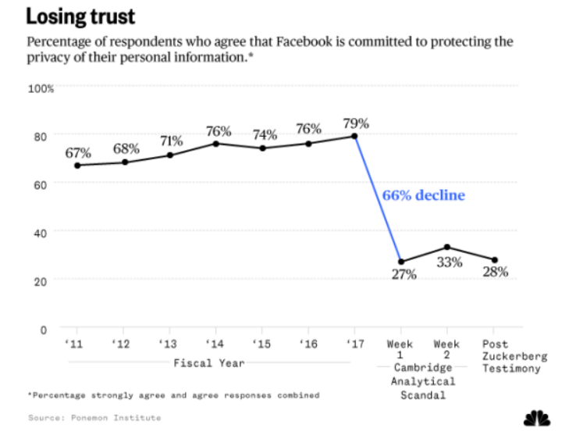
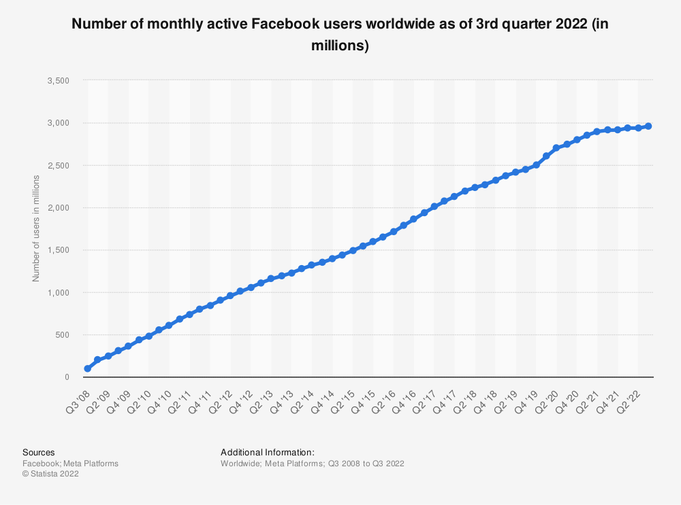

Slide 10
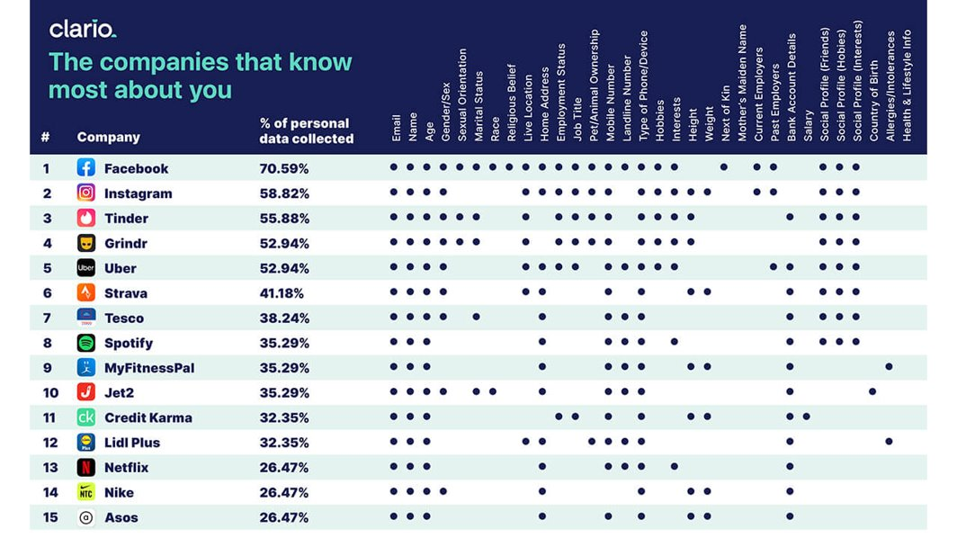
Uncertainty

Slide 11
Context-dependence
Theory of contextual integrity: The focus on groups is strategic and is providing rich data for Facebook. (Salvador Rodriguez, 2020)
Observing other people revealing info increases the likelihood one will do it too. (Salvador Rodriguez, 2020)
To have data privacy you have to check your privacy settings regularly and read the terms of use. (Stewart, E., 2018)

Slide 12
Context-dependence
Privacy fatigue: people feel exhausted from hearing about endless data breaches. (Hinds Joanne, 2020)
We feel vulnerable from the fake-news era we live in.

Slide 13
Malleability and Influence
Malicious interface design: Facebook’s privacy settings are by default not set for privacy.
Semantic trap: Facebook argues that it is not selling data, but rather selling targeted advertising. (Kosinski, 2018)

Slide 14
Malleability and Influence
The people whose job is to protect the user always fight with the people whose job is to make money for the company (Chang, A., 2018)
Zuckerberg has acknowledged it might be time for regulators to step in (Stewart, E., 2018)
“Security and privacy directly contradict Facebook’s business model”
“I don’t think Facebook is going to do anything meaningful on a voluntary basis”
Sally Hubbard, an expert
(Illing, S., 2018)

Slide 15
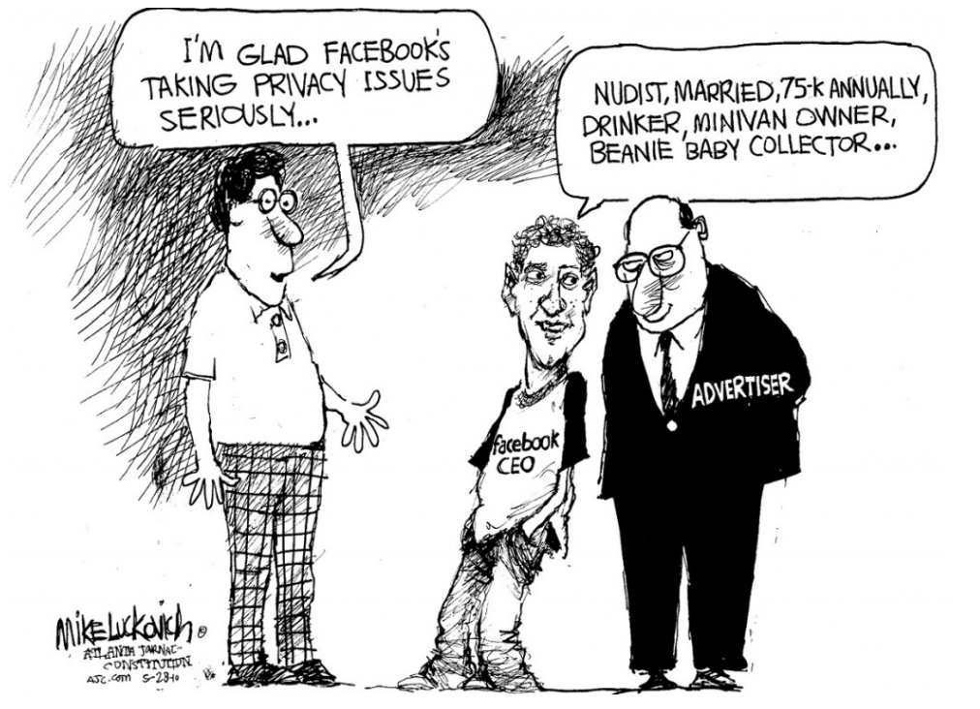
Influence

Slide 16

People trust Facebook their whole lives, providing the company with a lot of data that they can use as they please.
Digital footprints describe people’s personalities more accurate and valid other people's opinions. (Wu Youyou, 2015)
Protect your privacy, educate yourself about the risks, and be more thoughtful of what terms you accept.
Conclusions

Slide 17
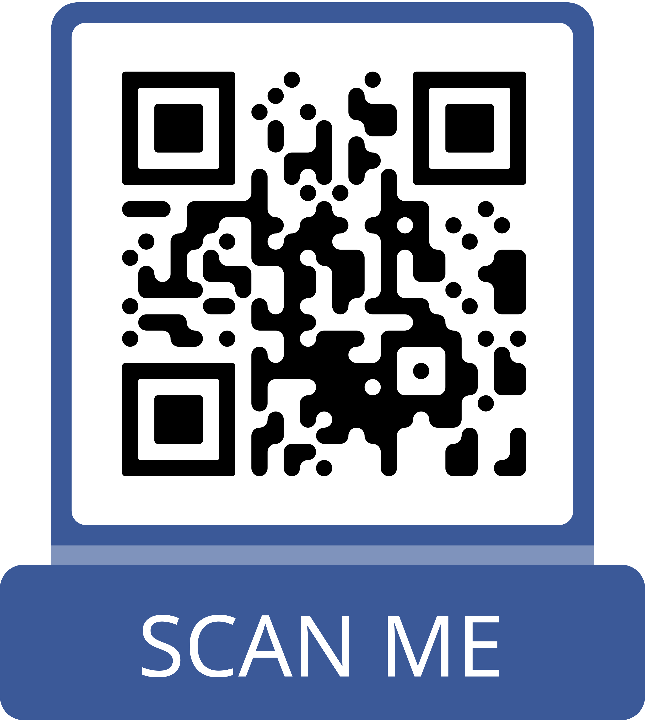
Reference List

Slide 18

Kick-off question
Should people drive more attention to their own data privacy, or should it be mostly the concern of government regulation?

Slide 19
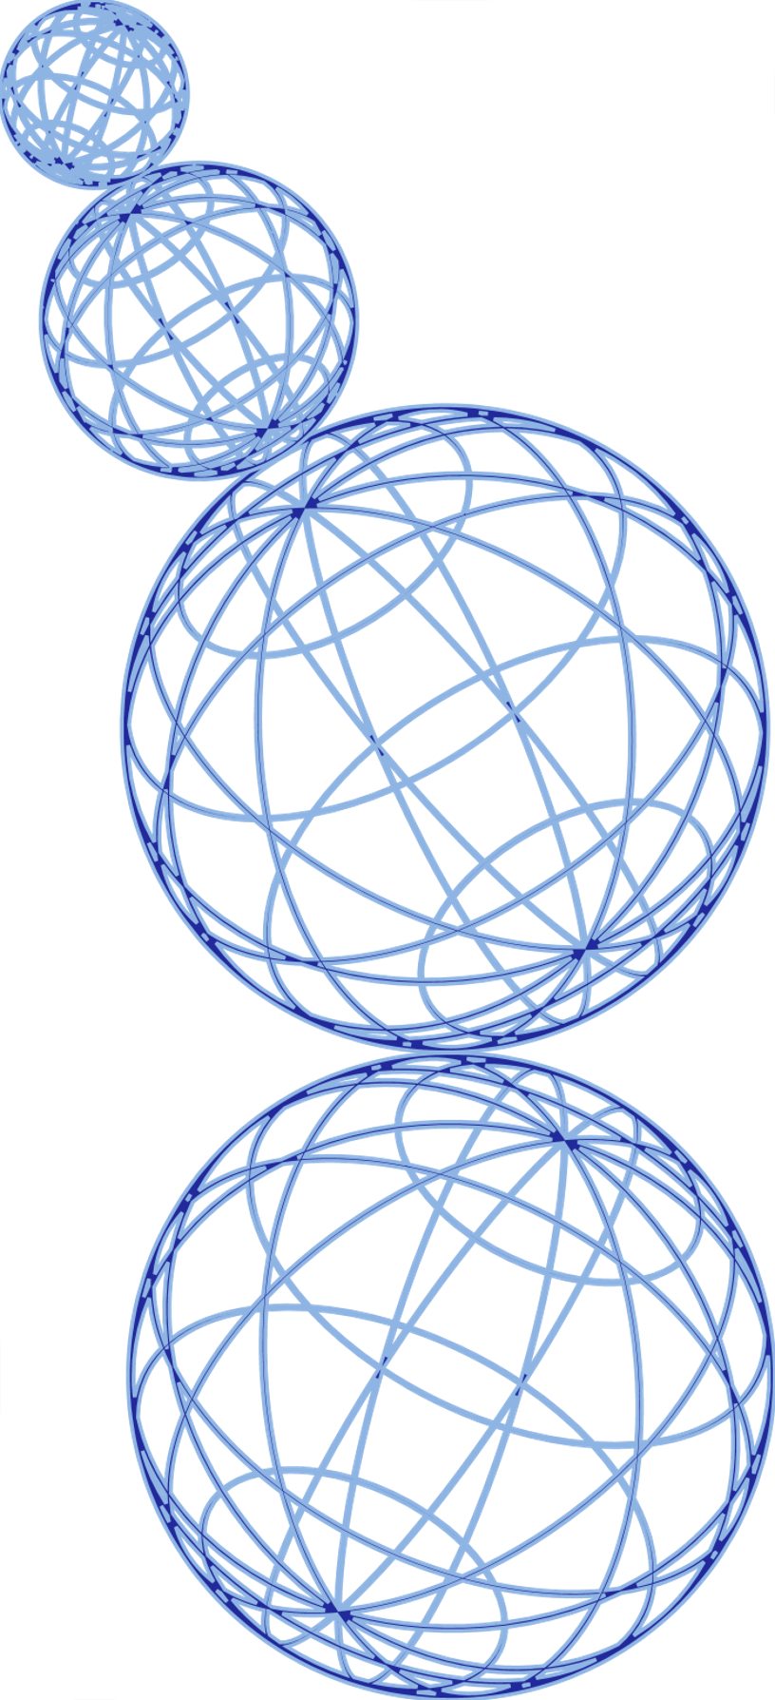
Reference List
1. Chang, A. (2018, May 2). The Facebook and Cambridge Analytica scandal, explained with a simple diagram. Vox’s explanatory journalism. https://www.vox.com/platform/amp/policy-and-politics/2018/3/23/17151916/facebook-cambridge-analytica-trump-diagram
2. Debatin, B. et al. (2009, October 1). Facebook and Online Privacy: Attitudes, Behaviors, and Unintended Consequences. Journal of Computer Mediated Communication, Volume 15, Issue 1, 1 October 2009, Pages 83-108. https://academic.oup.com/jcmc/article/15/1/83/4064812
3. Facebook Partners With Shadowy ‘Data Brokers’ To Farm Your Information. https://softcloudtech.com/facebook-partners-with-shadowy-data-brokers-to-farm-your-information/
4. Facebook's data-sharing deals exposed. (2018, December 19). BBC News. https://www.bbc.com/news/technology-46618582
5. Habib, M. (2020, March 23). Why Facebook’s User Agreement is Still Problematic. Readwrite. https://readwrite.com/why-facebooks-user-agreement-is-still-problematic/
6. Hinds J, Williams E, Joinson A (2020, June 12). “It wouldn't happen to me”: Privacy concerns and perspectives following the Cambridge Analytica scandal. El Sevier. https://pdf.sciencedirectassets.com/272548/1-s2.0-S107158192
7. Illing, S. (2018, April 11). “It’s pretty much the Wild West”: why we can’t trust Facebook to police itself. Vox’s explanatory journalism. https://www.vox.com/2018/3/21/17146674/zuckerberg-hearing-facebook-cambridge-analytica
8. Kosinski, M. (2018, December 13). Congress May Have Fallen for Facebook’s Trap, but You Don’t Have To. The New York Times. https://www.nytimes.com/2018/12/12/opinion/facebook-data-privacy-advertising.html

Slide 20
Reference List
9. Kozlowska, I. (2018, April 30). Facebook and Data Privacy in the Age of Cambridge Analytica. University of Washington. https://jsis.washington.edu/news/facebook-data-privacy-age-cambridge-analytica/
10. Rodriguez, S. (2020, February 16). Mark Zuckerberg shifted Facebook’s focus to groups after the 2016 election, and it’s changed how people use the site. CNBC. https://www.cnbc.com/2020/02/16/zuckerbergs-focus-on-facebook-groups-increases-facebook-engagement.html
11. Romano, A. (2018, March 20). The Facebook data breach wasn’t a hack. It was a wake-up call. Vox’s explanatory journalism. https://www.vox.com/2018/3/20/17138756/facebook-data-breach-cambridge-analytica-explained
12. Shneier, B. (2015, March 2), Data and Goliath: The Hidden Battles to Collect Your Data and Control Your World. W. W. Norton & Company; 1 edition.
13. Stewart, E. (2018, April 10). What the government could actually do about Facebook. Vox’s explanatory journalism. https://www.vox.com/policy-and-politics/2018/4/10/17208322/facebook-mark-zuckerberg-congress-testimony-regulation
14. Wilcox, K., Andrew T. Stephen (2012, October 3). Are Close Friends the Enemy? Online Social Networks, Self-Esteem, and Self-Control. SSRN. https://papers.ssrn.com/sol3/papers.cfm?abstract_id=2155864
15. Youyou, W. et al. (2015, January 12). Computer-based personality judgments are more accurate than those made by humans. Proceedings of the National Academy of Sciences (PNAS). https://www.pnas.org/doi/full/10.1073/pnas.1418680112

